Slide 1
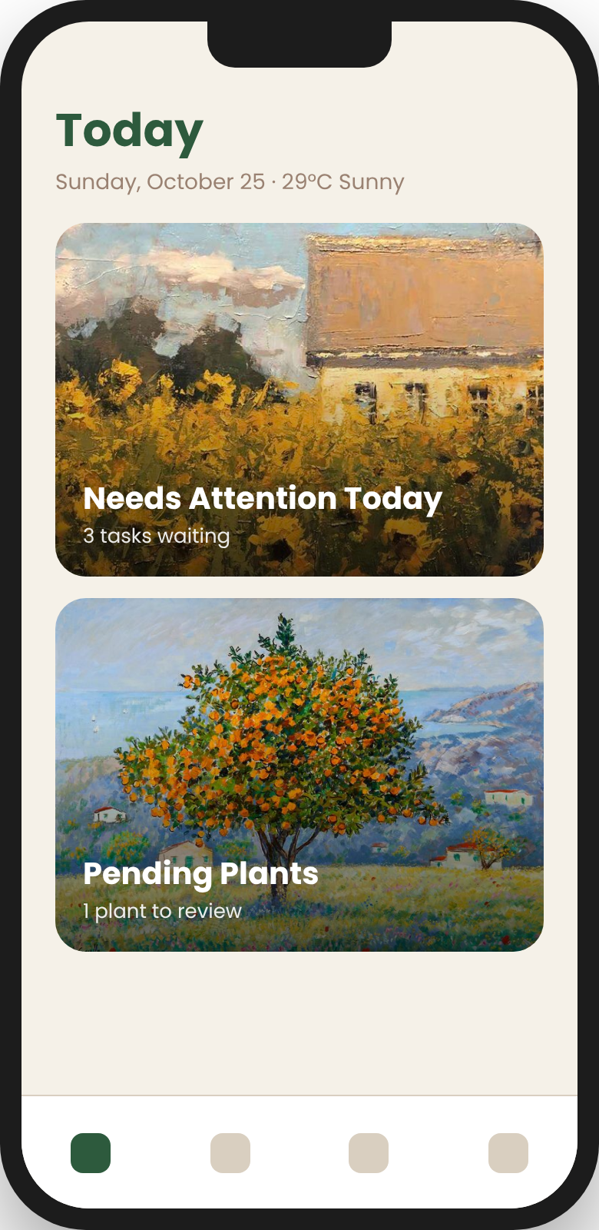
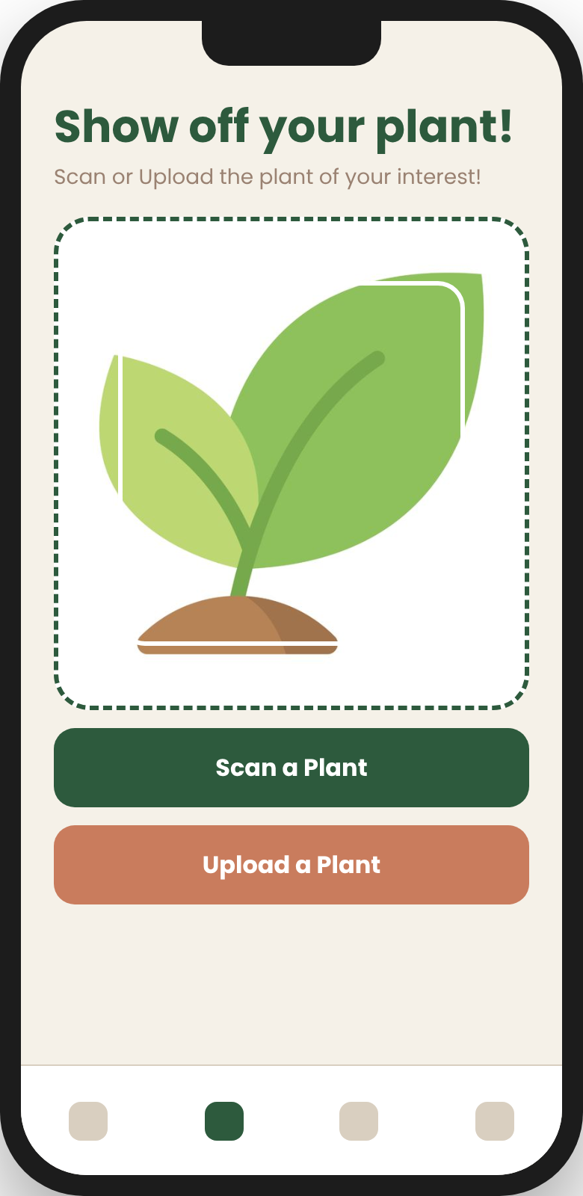
DRYAD
Gardening Assistant
Snap a plant. Get its care routine.
Never lose a plant to guesswork again.
CS 15 Project Pitch

Slide 2



THE PROBLEM
Plants die from guesswork
"What plant is this?"
Over- or under-watering
Weather is ignored
New gardeners can't identify what they own, so they can't look up how to care for it.
Generic "water every few days" advice ignores plant type, light, and soil.
Rain, heat waves and humidity change what a plant needs today.

Slide 3

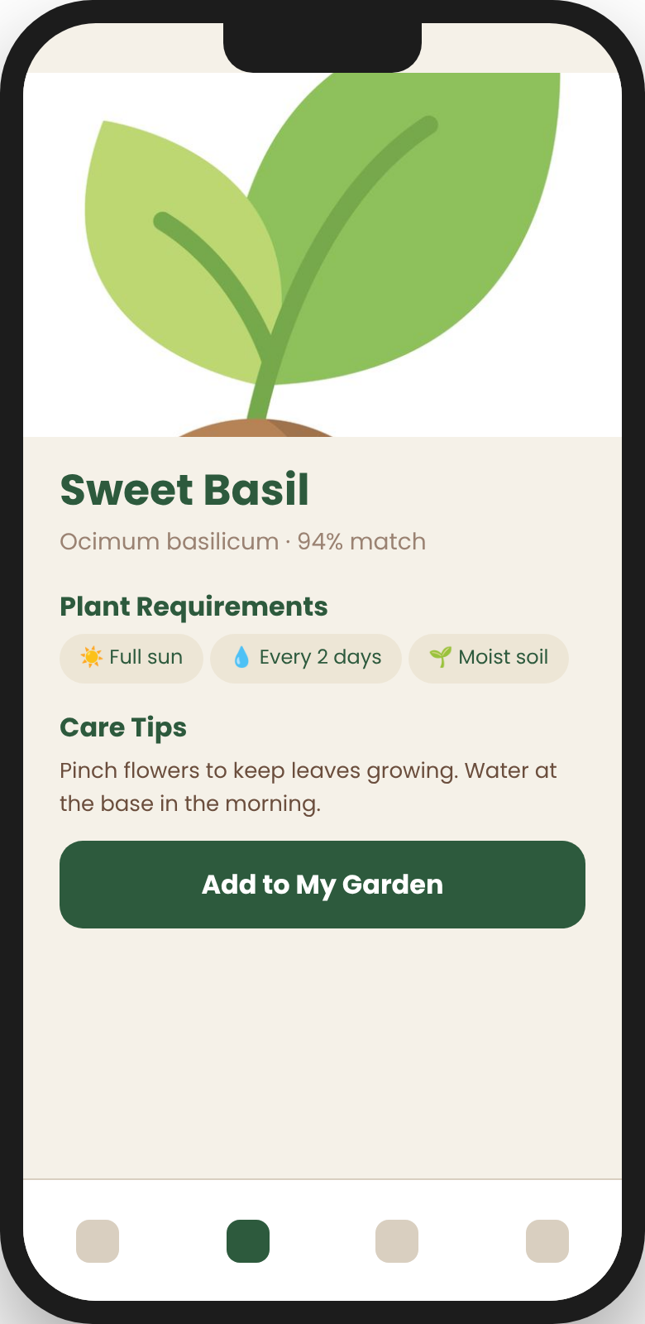



THE SOLUTION
Meet DRYAD
A pocket gardener that identifies your plant from a photo, builds its care routine, and tells you exactly what to do today — adjusted for your local weather.
Identify
Personalize
Remind
from one photo
care per plant
daily, weather-aware

Slide 4
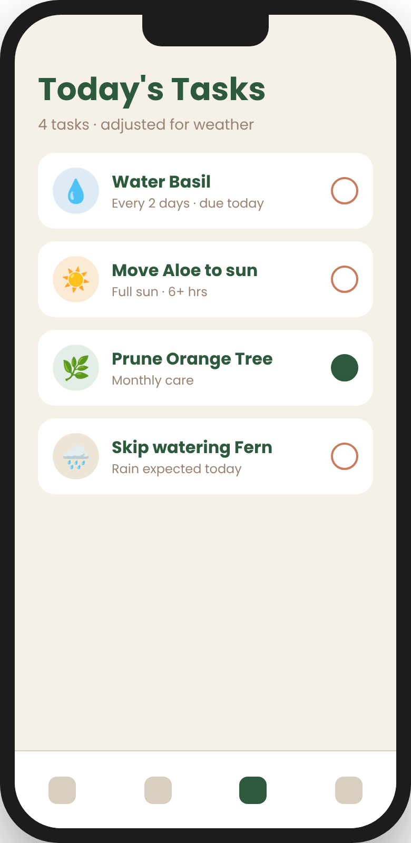
SEE IT IN ACTION
Scan. Learn. Grow.
1. Scan any plant
2. Get its care profile
3. Follow today's tasks

Slide 5





HOW IT WORKS
From photo to plan in four steps
01
02
03
04
Snap
Identify
Profile
Act
Take or upload a photo of any plant
Pl@ntNet AI returns the species
Trefle data on light, soil & humidity
Today's tasks, tuned to the weather

Slide 6
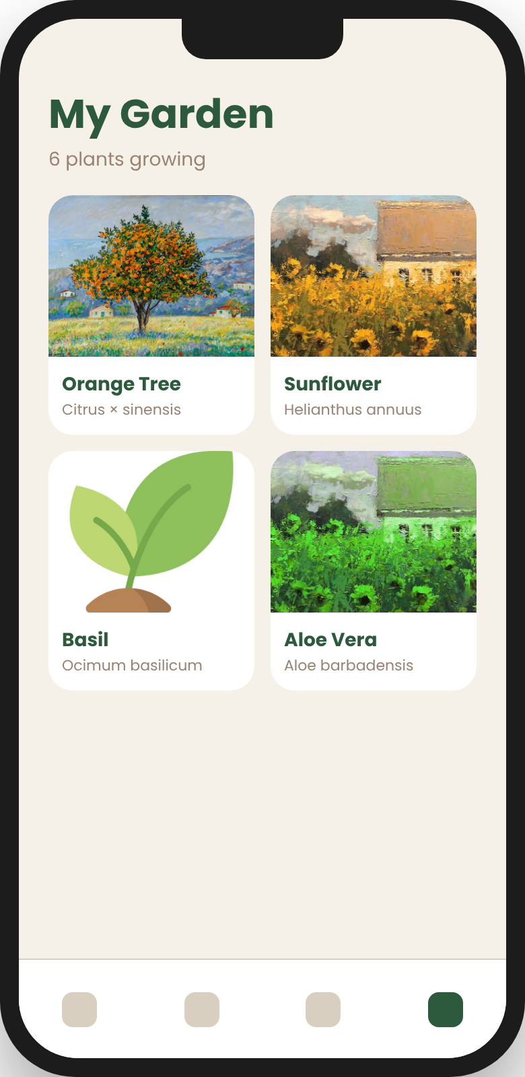





FEATURES
Everything a plant parent needs
Plant Scanner
My Garden
Camera or gallery identification
All your plants in one place
Today's Tasks
Pending Plants
Water, sun & care, due today
Review scans before adding
Archive
Works Offline
Keep a history of past plants
Local SQLite storage

Slide 7

SMART CARE LOGIC
Watering that adapts to each plant
10 days
4 days
2 days
1 day
Dry-habitat plants
Average plants
Moisture lovers
Bog & aquatic
Then it adjusts: full-sun plants get watered a day sooner, shade plants a day later — and live weather can skip watering when it rains.

Slide 8






UNDER THE HOOD
Built on a modern mobile stack
React Native + Expo
Expo SQLite
Pl@ntNet API
One codebase for Android & iOS
Fast, offline-first local data
AI plant identification
Trefle API
Weather API
Expo Location
Botanical care data
Live local conditions
Weather for where you are

Slide 9
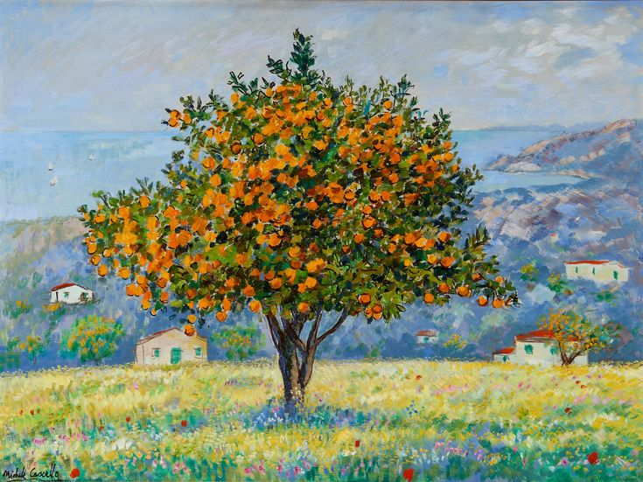


WHO IT'S FOR
Made for everyday growers
Home & balcony gardeners
Busy people who want healthy plants with less effort
First-time plant owners
Beginners who don't yet know what they're growing
Backyard & small farms
Growers who need weather-aware routines

Slide 10
ROADMAP
Where DRYAD grows next
Now
Next
Later
Future
Scan, garden, daily tasks, weather & offline storage
Push notifications and growth photo journal
Disease detection from leaf photos
Community tips and plant sharing

Slide 11
Let your garden grow with DRYAD
Thank you — questions?

